Slide 1
Data Structure and Algorithms
(CS212)
Instructor : Syed Musharaf Ali
ROOM G-104-DSE IIUI
Ph# 051-9019724 Ext-2724
Email: musharaf.ali@iiu.edu.pk

Slide 2
Threaded Binary Tree
A binary tree is represented using array representation or linked list representation.
When a binary tree is represented using linked list representation, if any node is not having a child we use NULL pointer in that position.
In any binary tree linked list representation, there are more number of NULL pointer than actual pointers.
Generally, in any binary tree linked list representation, if there are 2N number of reference fields, then N+1 number of reference fields are filled with NULL ( N+1 are NULL out of 2N ).
This NULL pointer does not play any role except indicating there is no link (no child).
J. Perlis and C. Thornton have proposed new binary tree called "Threaded Binary Tree", which make use of NULL pointer to improve its traversal processes.
In threaded binary tree, NULL pointers are replaced by references to other nodes in the tree, called threads.

Slide 3
Threaded Binary Tree
Definition:
Threaded Binary Tree is also a binary tree in which
All left child pointers that are NULL (in Linked list representation) points to its in-order predecessor,
All right child pointers that are NULL (in Linked list representation) points to its in-order successor.
If there is no in-order predecessor or in-order successor, then it point to root node.

Slide 4
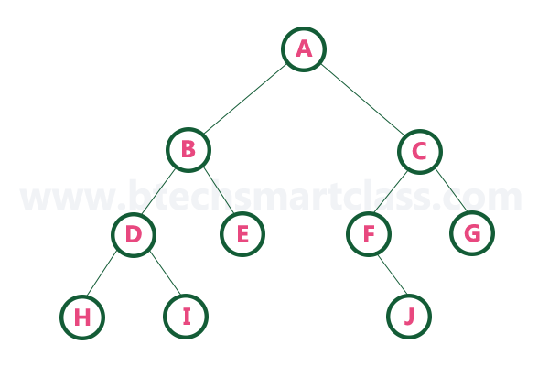
Threaded Binary Tree
Example: For the given Binary tree, first find the In-order traversal

Slide 5
Threaded Binary Tree
Example: For the given Binary tree, first find the In-order traversal
In-order traversal of above binary tree...H - D - I - B - E - A - F - J - C - G

Slide 6
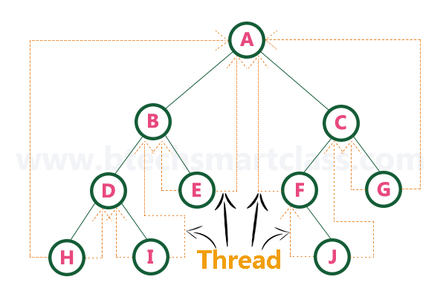
Threaded Binary Tree
Example: For the given Binary tree, first find the In-order traversal
http://btechsmartclass.com/DS/U3_T5.html

Slide 7
Heap Data Structure
In heap data structure, nodes are arranged based on their value. A heap data structure, some time called as Binary Heap. There are two types of heap data structures and they are as follows...
Max Heap
Min Heap

Slide 8
Heap Data Structure
Every heap data structure has the following properties...
Property #1 (Ordering): Nodes must be arranged in a order according to values based on Max heap or Min heap.
Property #2 (Structural): All levels in a heap must full, except last level, nodes must be filled from left to right strictly.

Slide 9
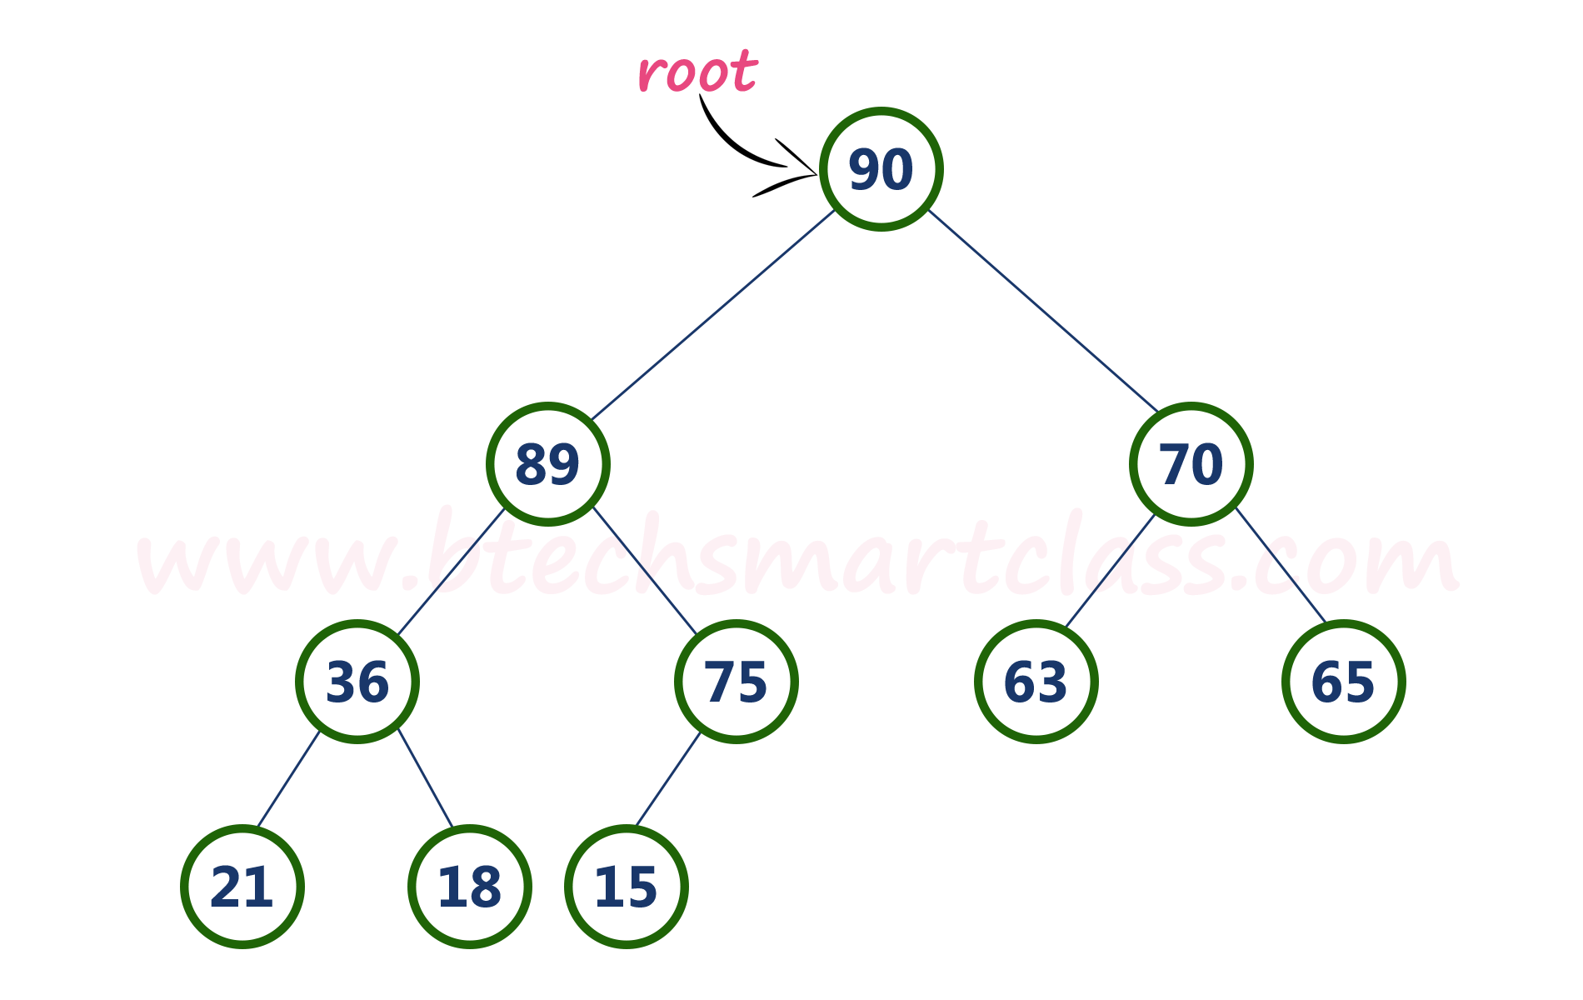
Max Heap
Definition:
Max heap is a specialized full binary tree in which every parent node contains greater or equal value than its child nodes. And last leaf node can be alone.
Above tree is satisfying both Ordering property and Structural property according to the Max Heap data structure.

Slide 10
Max Heap
Operations on Max Heap
The following operations are performed on a Max heap data structure...
Finding Maximum
Insertion
Deletion

Slide 11
Max Heap
Finding Maximum Value Operation in Max Heap
Finding the node which has maximum value in a max heap is very simple. In max heap, the root node has the maximum value than all other nodes in the max heap. So, directly we can display root node value as maximum value in max heap.

Slide 12
Max Heap
Insertion Operation in Max Heap
Insertion Operation in max heap is performed as follows...
Step 1: Insert the newNode as last leaf from left to right.
Step 2: Compare newNode value with its Parent node.
Step 3: If newNode value is greater than its parent, then swap both of them.
Step 4: Repeat step 2 and step 3 until newNode value is less than its parent nede (or) newNode reached to root.

Slide 13
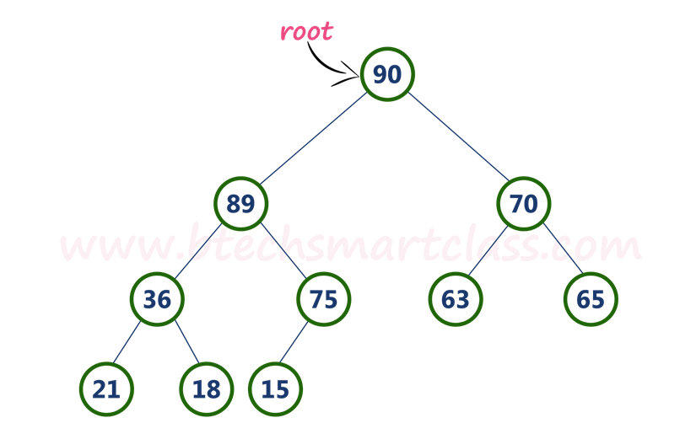
Max Heap
Insertion Operation in Max Heap
Example: For the given Heap, Insert new node with value 85

Slide 14
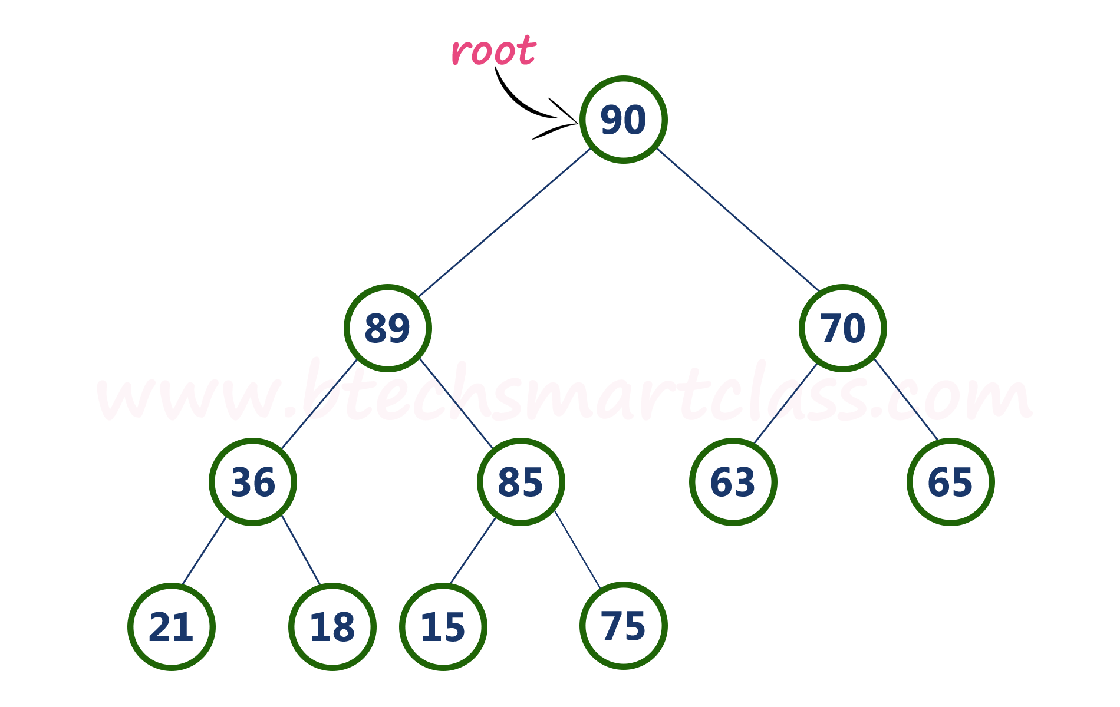
Max Heap
Insertion Operation in Max Heap
Example: For the given Heap, Insert new node with value85
Result

Slide 15
Max Heap
Deletion Operation in Max Heap
In a max heap, deleting last node is very simple as it is not disturbing max heap properties. Deleting root node from a max heap is little difficult as it disturbing the max heap properties.

Slide 16
Max Heap
Deletion Operation in Max Heap
We use the following steps to delete root node from a max heap...
Step 1: Swap the root node with last node in max heap
Step 2: Delete last node.
Step 3: Now, compare root value with its left child value.
Step 4: If root value is smaller than its left child, then compare left child with its right sibling. Else goto Step 6
Step 5: If left child value is larger than its right sibling, then swap root with left child. otherwise swap root with its right child.
Step 6: If root value is larger than its left child, then compare root value with its right child value.
Step 7: If root value is smaller than its right child, then swap root with right child. otherwise stop the process.
Step 8: Repeat the same until root node is fixed at its exact position.

Slide 17
Max Heap
Deletion Operation in Max Heap
Example: Delete root node (90) from the max heap.

Slide 18

Max Heap
Deletion Operation in Max Heap
Example: Delete root node (90) from the max heap.
Result
http://btechsmartclass.com/DS/U3_T7.html

